Slide 1
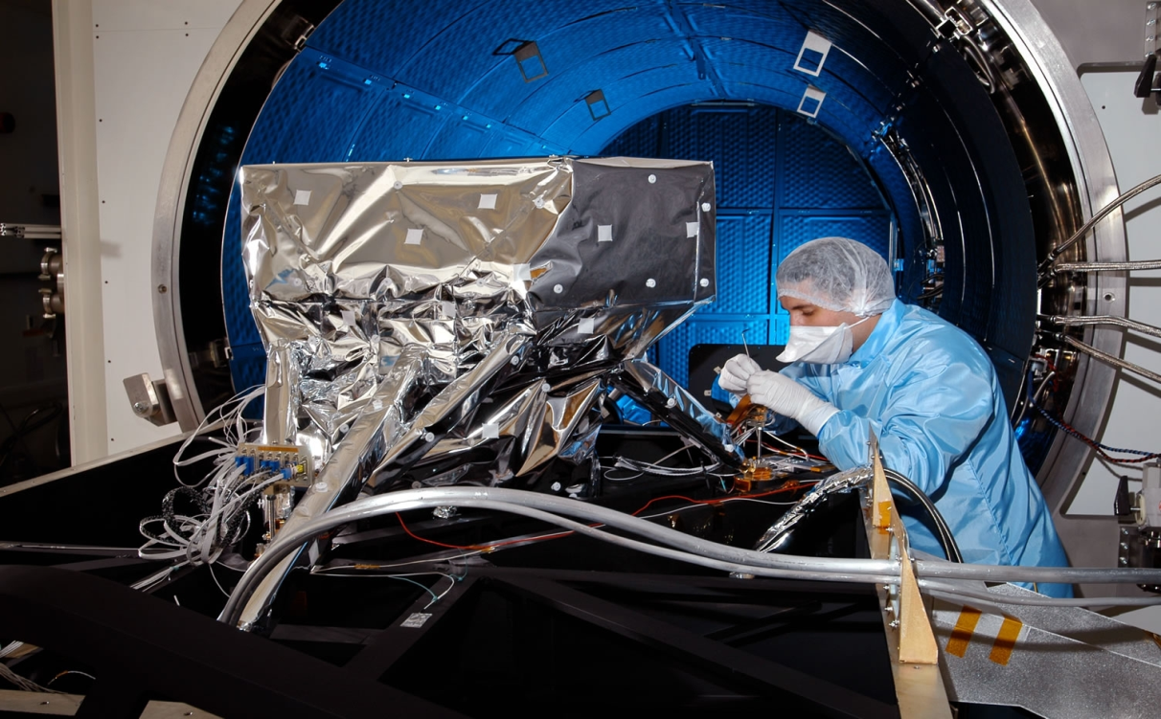
Thermal Engineering for Space

Slide 2
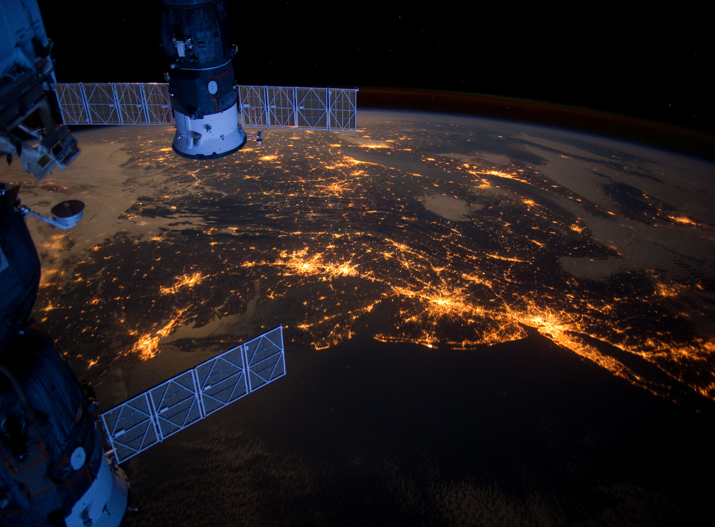
Is space hot or cold?
Space is cold – approx 2.7 Kelvin (-270 C)
Stars are the only source of heat in space
Away from stars, space is really cold
BOTH!
Space is hot…
The surface of the sun is around 3.5 million degrees C
The Earth’s atmosphere protects us
The sunny side of the moon can be hotter than the Sahara

Slide 3
Heat and Temperature
Are they the same
thing?

Slide 4
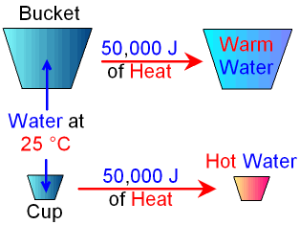
Heat and Temperature
There’s a difference between heat and temperature
Heat is a form of energy (measured in Joules)
Temperature is the intensity of heat in a substance
The more heat, the higher the temperature gets

Slide 5
How is heat transferred?
Can anyone name the three ways heat can be transferred?
Conduction
Convection
Radiation

Slide 6
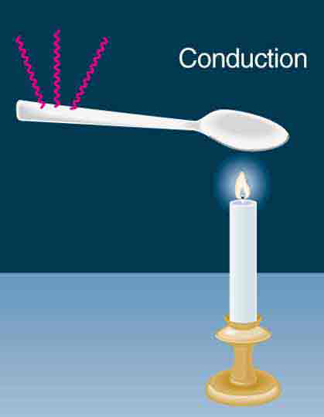
How is heat transferred?
Conduction
The transfer of energy between objects in physical contact

Slide 7

How is heat transferred?
Conduction
Convection
Transfer of energy between an object and its environment due to fluid motion

Slide 8
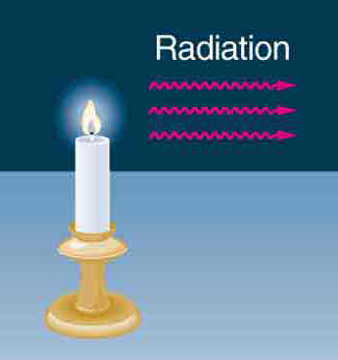
How is heat transferred?
Conduction
Convection
Radiation
Transfer of energy by electromagnetic waves

Slide 9
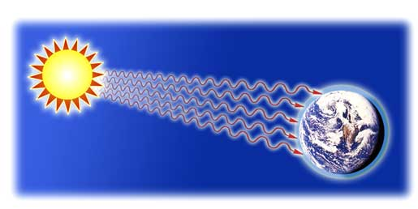
How is heat transferred in space?
Space is a vacuum (approximately 1 atom per cm³)
Conduction and convection in space are almost entirely non-existent
Heat from the Sun travels to Earth via radiation

Slide 10
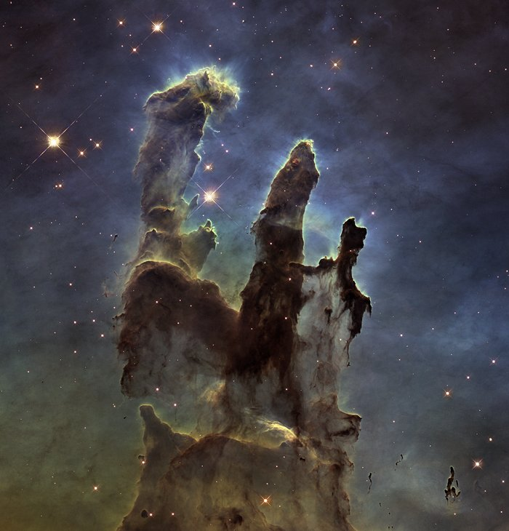
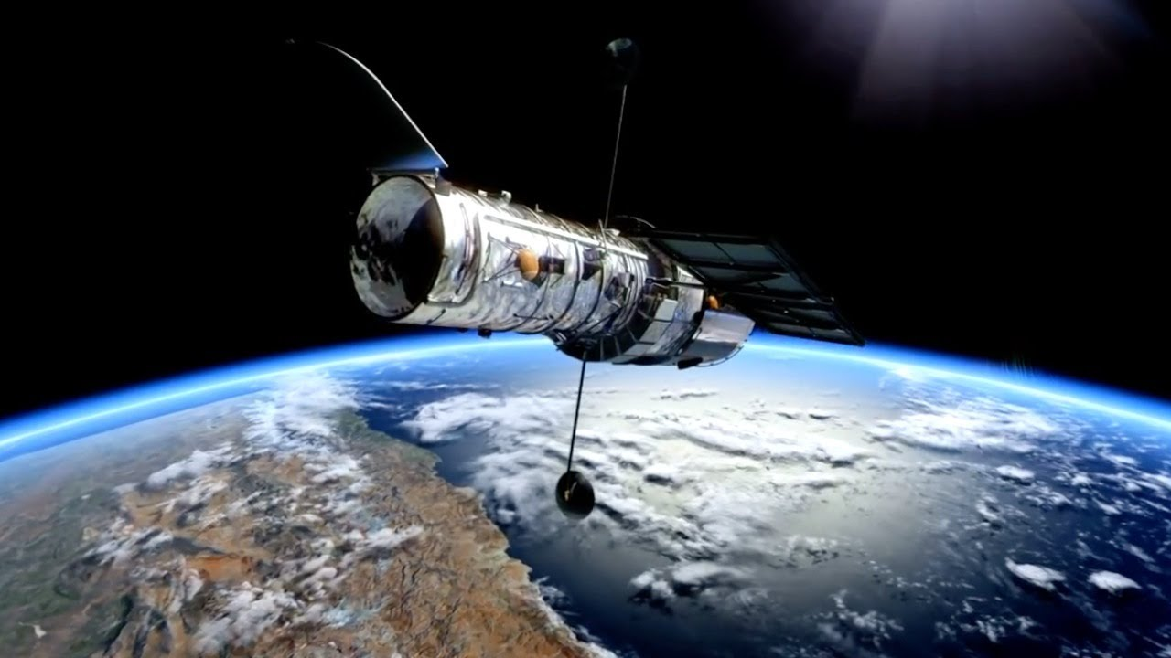
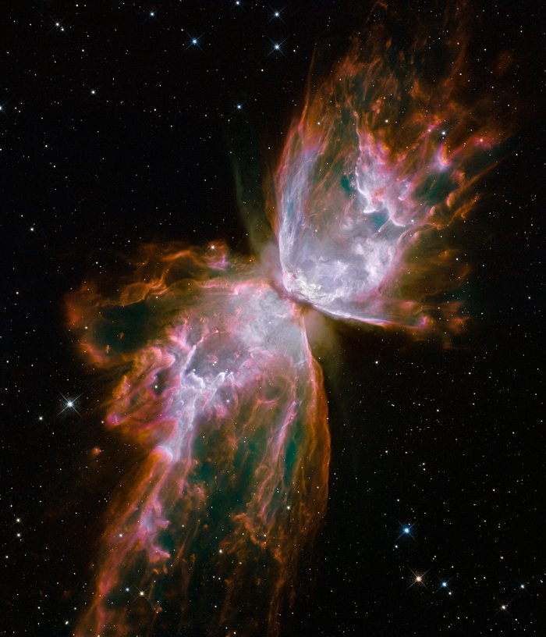
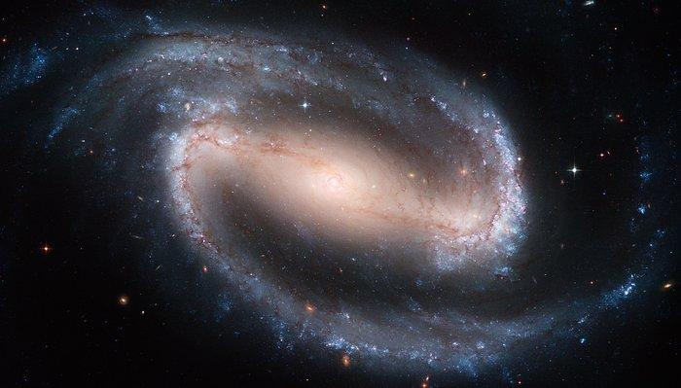
Hubble Space Telescope

Slide 11
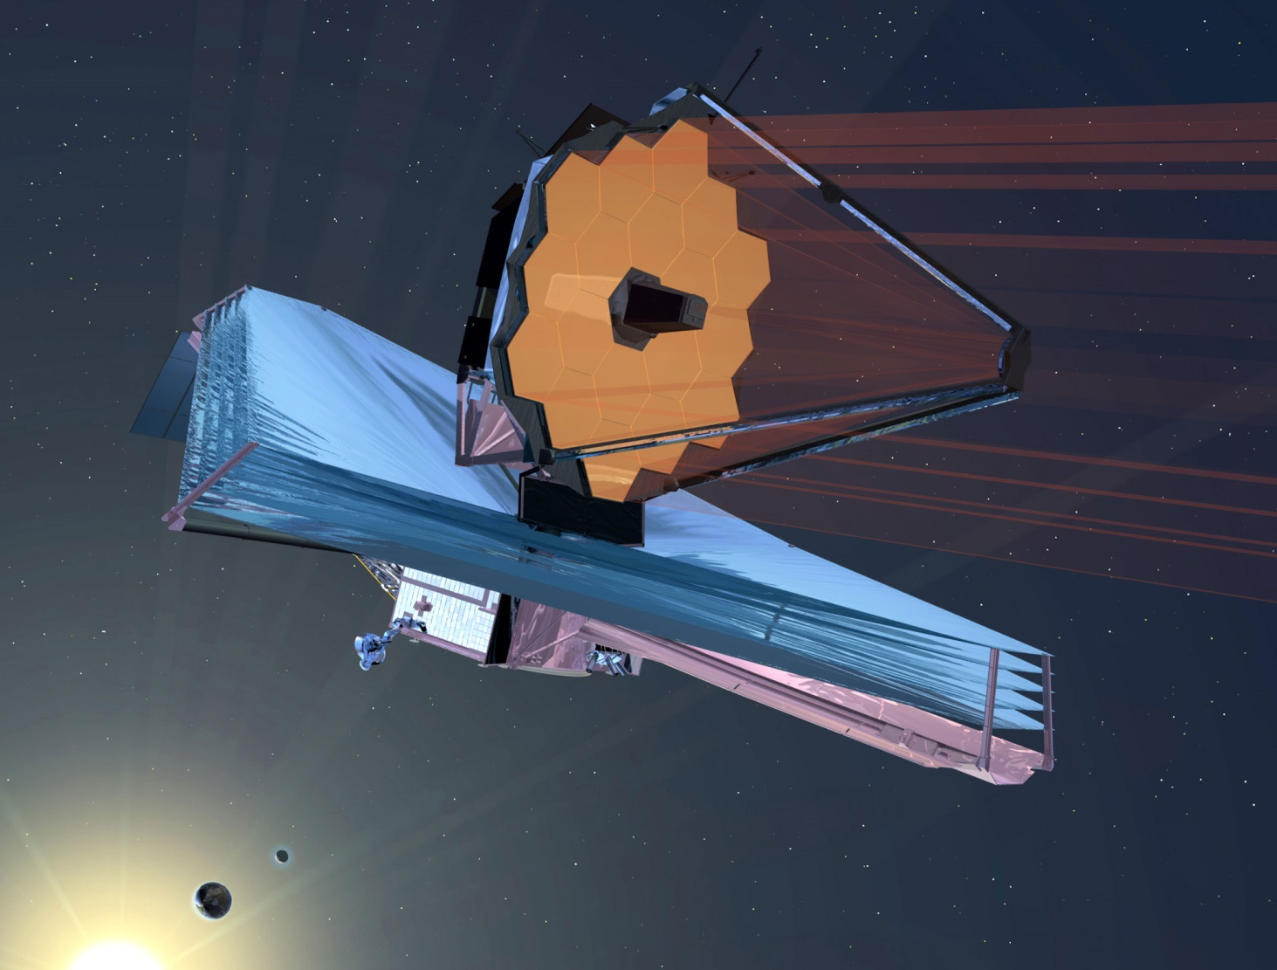
James Webb Space telescope

Slide 12
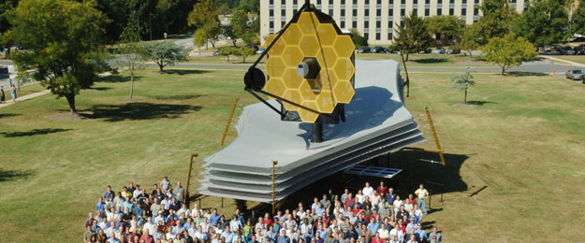
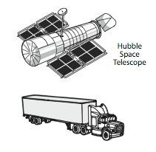
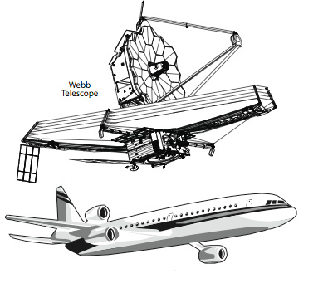
Notes:
Near Infrared Camera (NIRCam)
Near Infrared Spectrograph (NIRSpec)
Mid Infrared Instrument (MIRI)
Fine Guidance Sensors/Near Infrared Imager and Slitless Spectrograph (FGS/NIRISS)

Slide 14
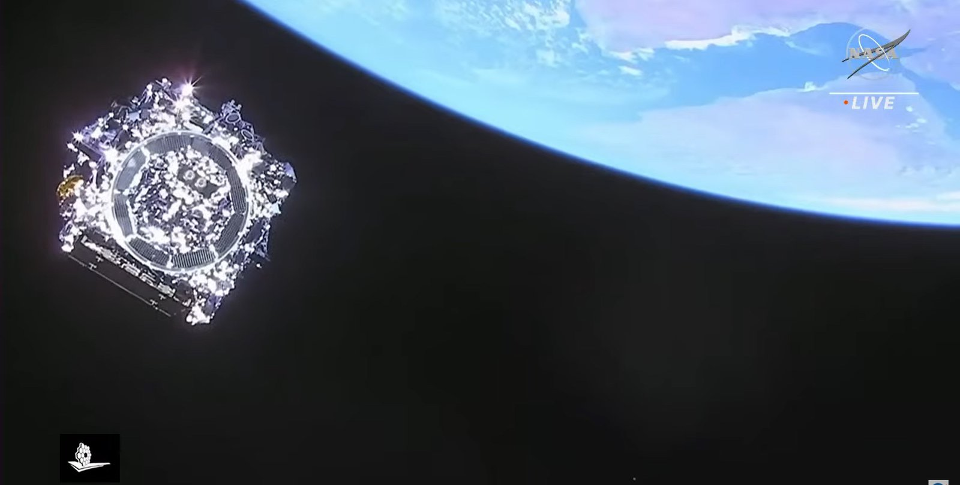
James Webb Space telescope
Launched 25 Dec 2021

Slide 15
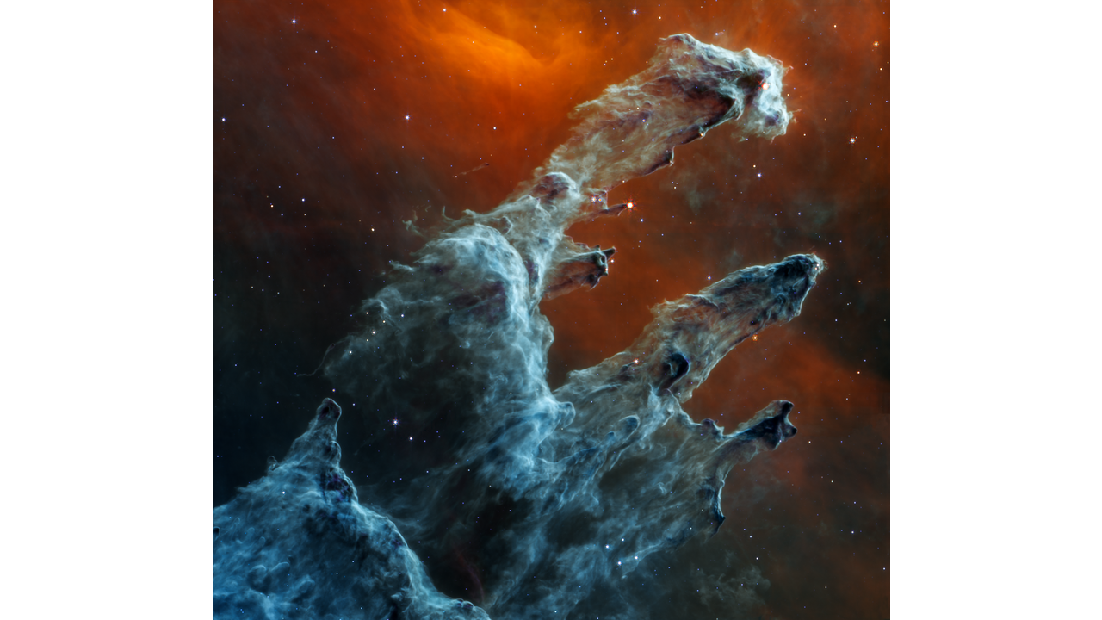
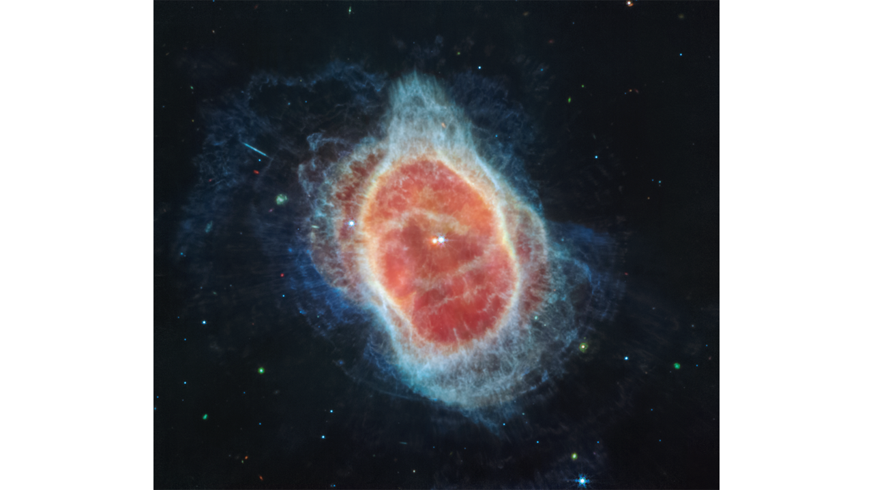
Southern Ring Nebula (MIRI Image)
Pillars of Creation (MIRI Image)

Slide 16
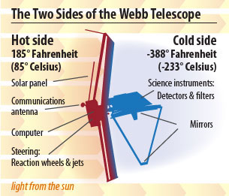
How is heat transferred?

Slide 17
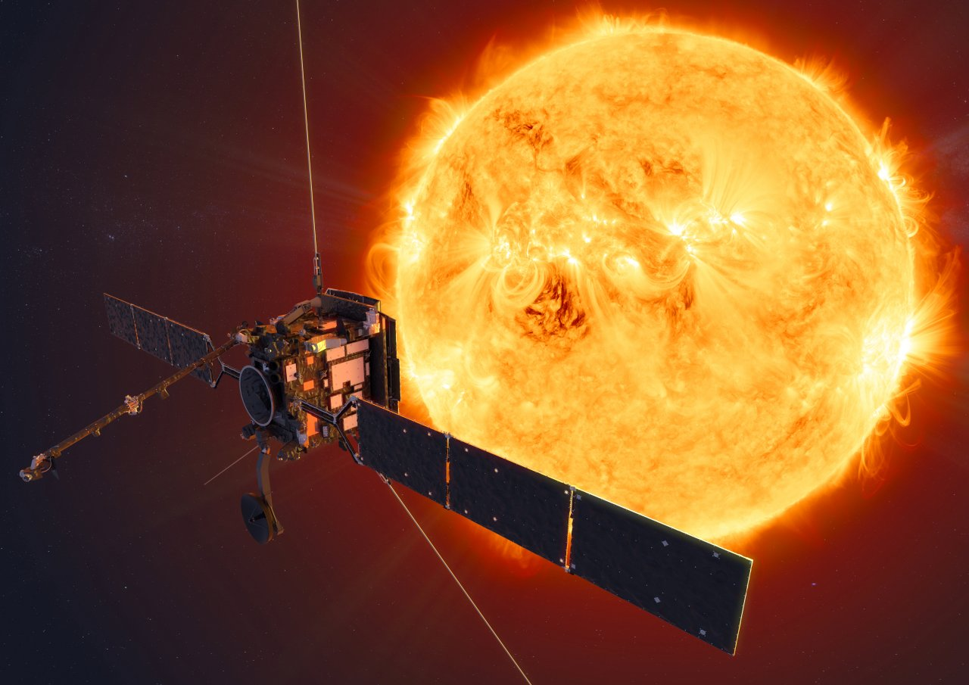
Solar Orbiter
Notes:
http://www.esa.int/Science_Exploration/Space_Science/Solar_Orbiter_overview
This is the solar orbiter overview site. To perform close-up, high-resolution studies of our Sun and inner heliosphere, Solar Orbiter is intended to brave the fierce heat and carry its telescopes to just one-quarter of Earth's distance from our nearest star. Solar Orbiter will be the first satellite to provide close-up views of the Sun's polar regions, which are very difficult to see from Earth, providing images from high latitudes. It will also be able to see solar storms building up over an extended period from the same viewpoint, delivering data of parts of the Sun not visible from Earth. Solar Orbiter will be exposed to sunlight 13 times more intense than what we feel on Earth. The spacecraft must also endure powerful bursts of atomic particles from explosions in the solar atmosphere. Solar Orbiter is designed to identify the origins and causes of the solar wind, the heliospheric magnetic field, the solar energetic particles, the transient interplanetary disturbances, and the Sun's magnetic field. Launched 10 feb 2020 RAL Space leads an international consortium that designed, developed and calibrated an Extreme Ultraviolet Spectrometer, SPICE (Spectral Investigation of the Coronal Environment). The RAL Space team will also be involved in the post-launch operations of SPICE.

Slide 18
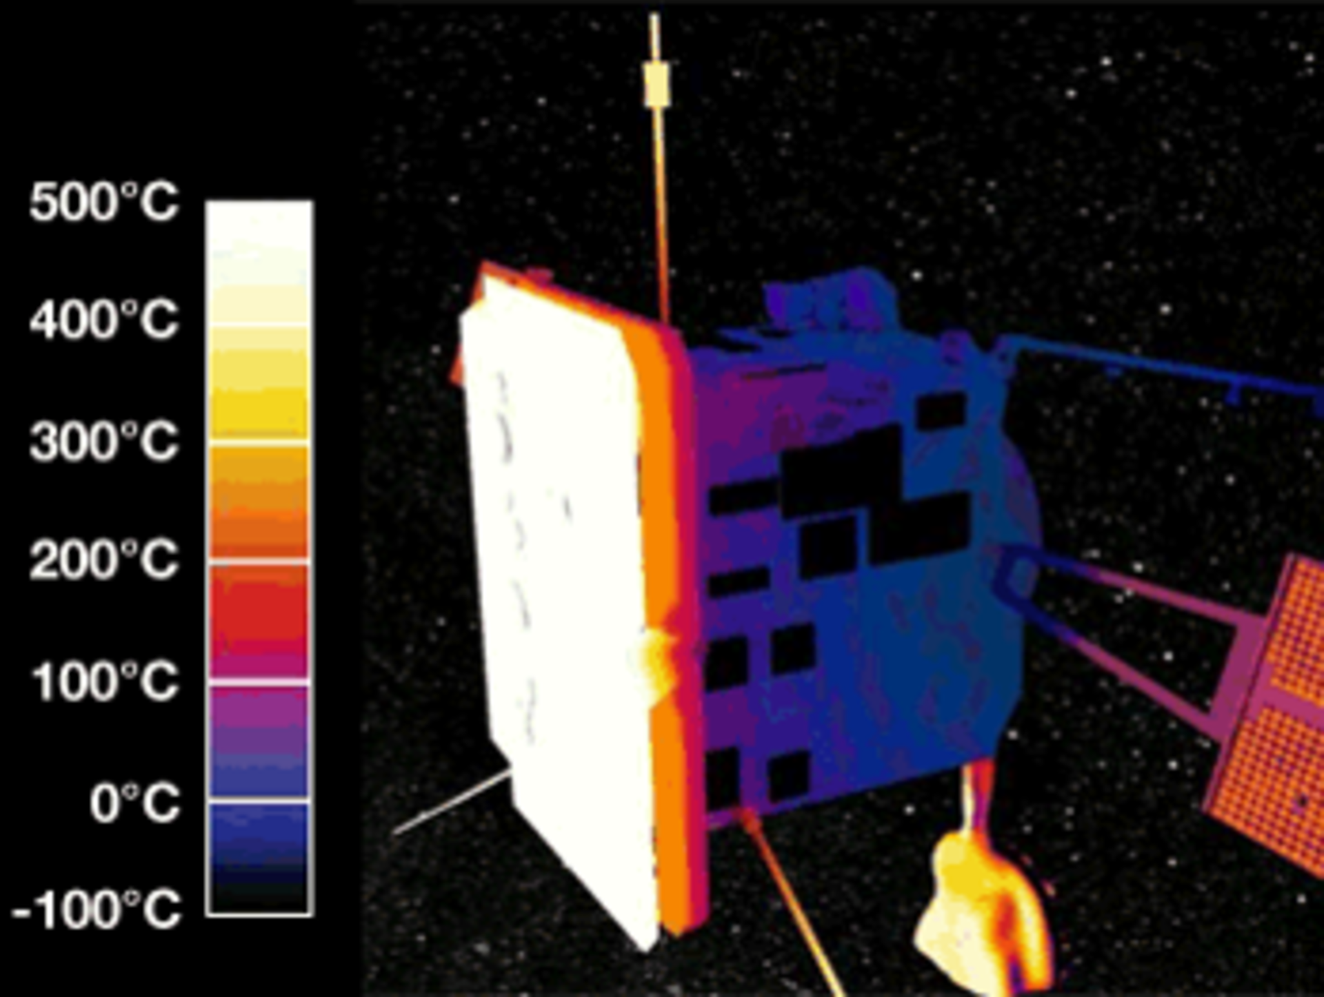
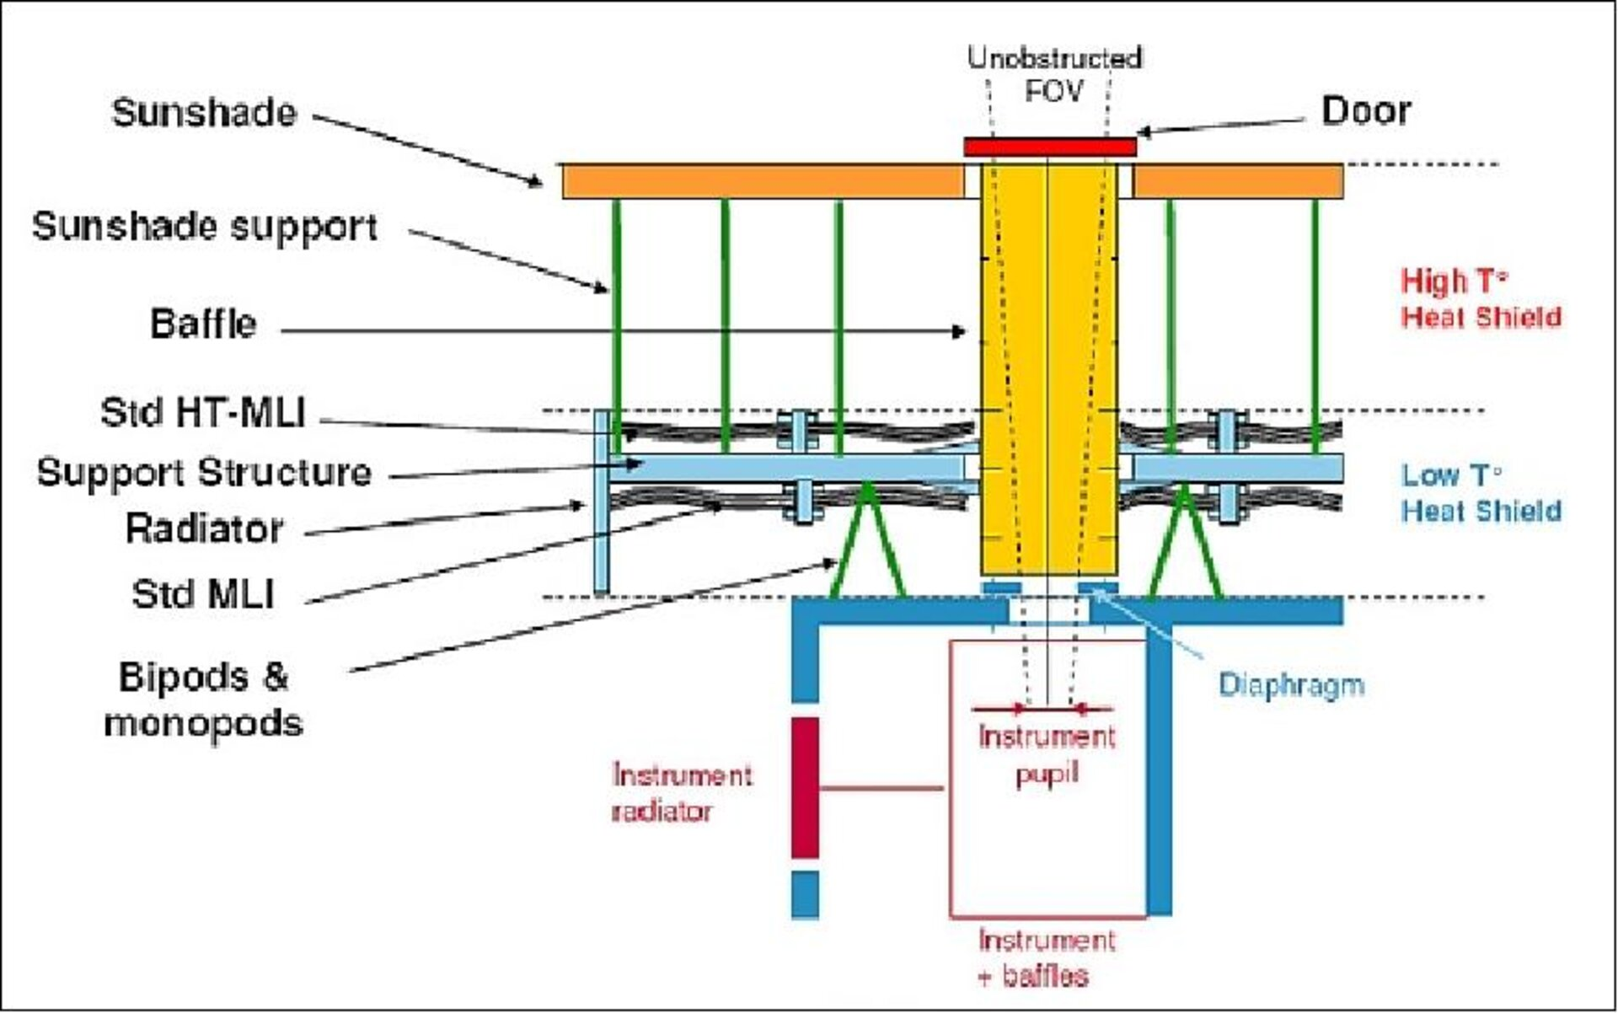
Notes:
https://www.esa.int/Enabling_Support/Space_Engineering_Technology/Shielding_Solar_Orbiter_from_the_Sun
This is a good website to describe how the heatshield works.
about as close as it is possible to go and still be able to image our fiery parent star without having its instruments melt. Its cameras will peek through an advanced shield designed to dissipate heat while keeping the rest of the spacecraft within a protective cone of shadow. This heat shield took years to perfect. a thin surface layer of titanium foil just 0.05 mm thick – around the width of a human hair – is backed up by 18 layers of specially tailored titanium multi-layer insulation.

Slide 19
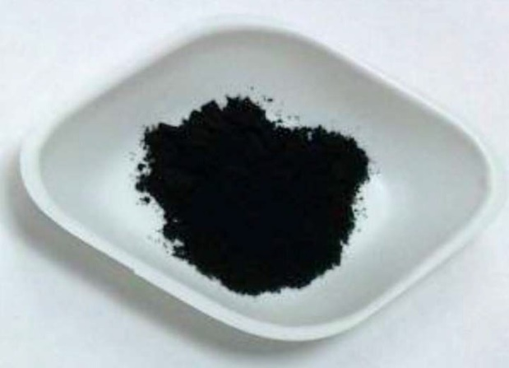
Solar Black Paint
Solar Orbiter needs to deal with over 500°C which is why it needs a heat shield. No usual spacecraft paint would be able to survive the heat of the sun for it’s 7 year life. This is why Solar Black was made.
It was initially made for coating hip replacements, and is made out of burnt animal bones! It turns out that it created a paint perfect for this job.
Notes:
https://www.esa.int/Enabling_Support/Space_Engineering_Technology/Paint_it_black_Stone_Age_sunscreen_for_Solar_Orbiter
This is a good website describing the paint

Slide 20
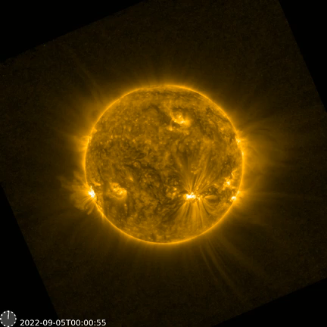
Notes:
Solar snake spotted slithering across Sun’s surface
14/11/2022
Solar Orbiter has spotted a ‘tube’ of cooler atmospheric gases snaking its way through the Sun’s magnetic field. The observation provides an intriguing new addition to the zoo of features revealed by the ESA-led Solar Orbiter mission, especially since the snake was a precursor to a much larger eruption.
The snake was seen on 5 September 2022, as Solar Orbiter was approaching the Sun for a close pass that took place on 12 October. It is a tube of cool plasma suspended by magnetic fields in the hotter surrounding plasma of the Sun’s atmosphere.
The movie has been constructed as a time-lapse from images from the Extreme Ultraviolet Imager onboard Solar Orbiter. In reality, the snake took around three hours to complete its journey but at the distances involved in crossing the solar surface that means the plasma must have been travelling at around 170 kilometres per second.

Slide 21
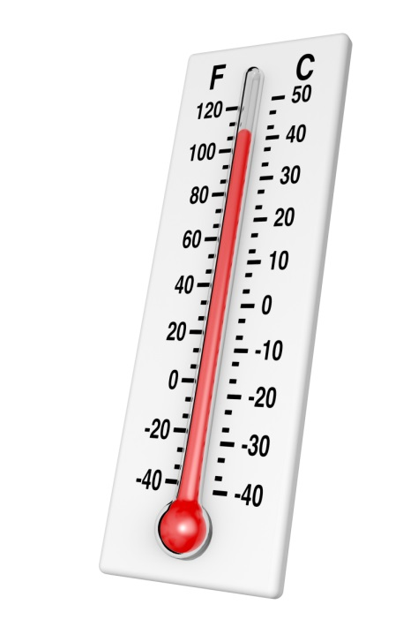

Your Challenge!
Investigate the thermal insulation properties of various materials, and design and construct your own thermal insulation system.
Make an effective insulation jacket for your beaker of hot water. You must be able to remove the jacket and the thermometer must not be fixed in. The beaker and jacket must fit into the rocket housing!
Notes:
Measure the temperature of the water at the start and at regular intervals.
Make sure you can get your thermometer in and out of the beakers (one per team)
Record your results throughout
Be prepared to give a presentation at the end on what you did, why and your results

Slide 22
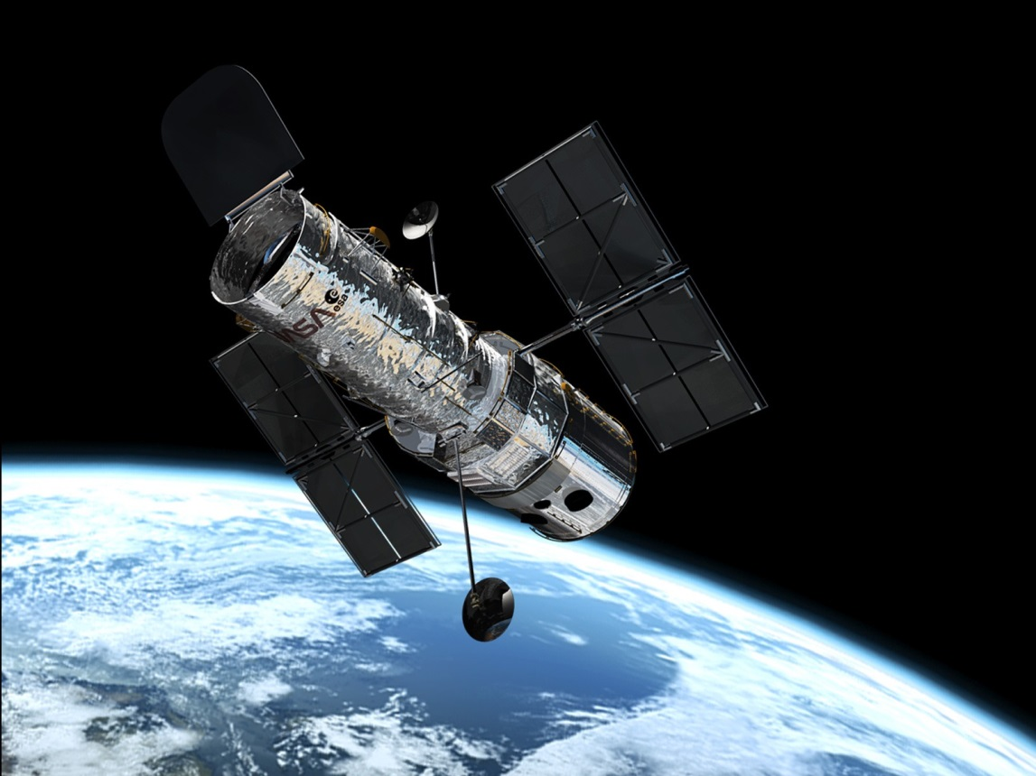
Real Life Challenges:
Parameters to Consider
Temperatures
Size of rocket
Purpose of mission
Weight
Thermal conductivity
Other instruments
Budgets/costs
Notes:
Temperatures – what conditions will it encounter
Size of rocket – it’s got to fit in your rocket housing
Purpose of mission – what will it do when it gets there
Weight – is important
Thermal conductivity – needs to be the best insulation from inside and out
Other instruments – instruments produce heat or need to be kept cool
Budgets/costs

Slide 23
Your Challenge!
In groups of 2 or 3…
You have approximately:
5 minutes to look at materials and design your insulation
20 minutes to construct your insulation jacket
10 minutes testing time
At the end you will give a 1 minute presentation to the rest of the groups on what you did, why and your results
You will need to pick up:
1 beaker
1 thermometer
Sticky tape & scissors (stapler if you want one)
Pencil (if needed)

Slide 24


Any Questions?

Slide 25
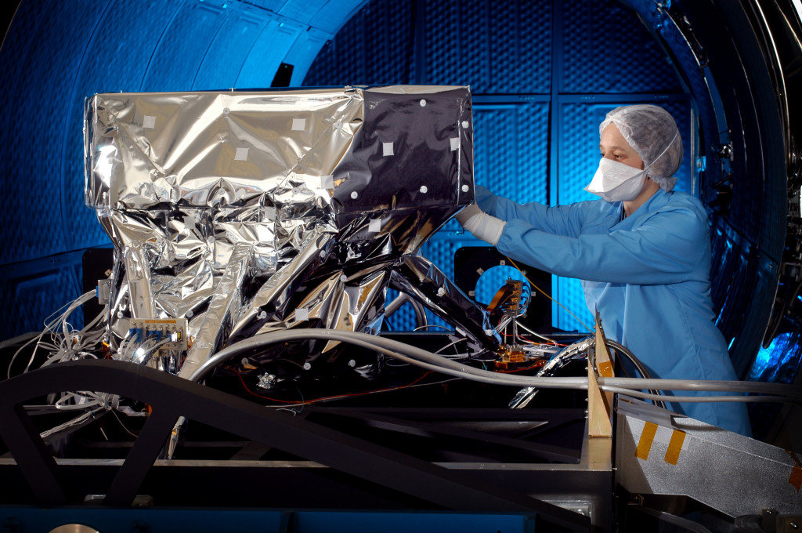
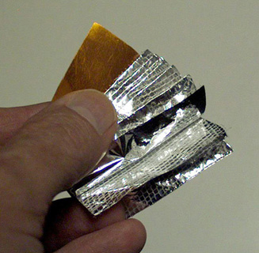
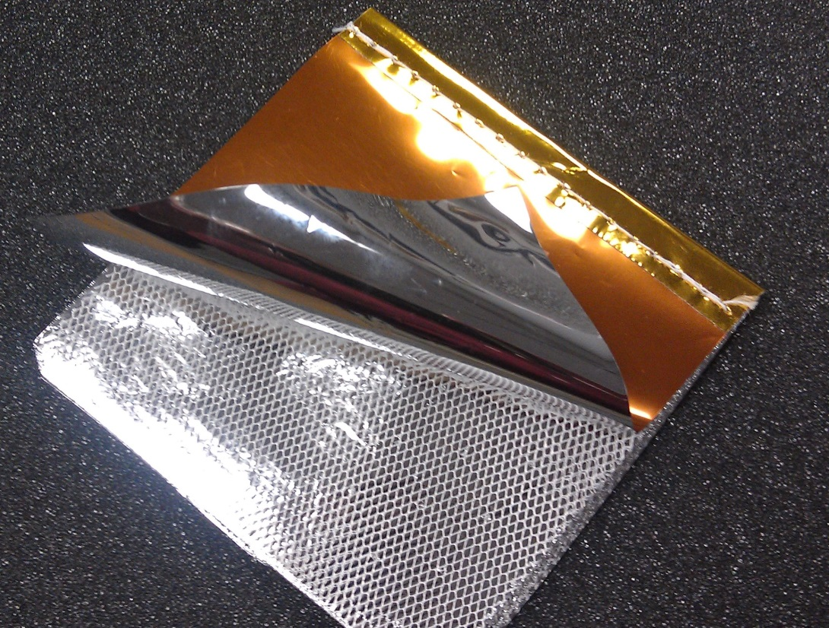
Multi-Layer Insulation
(MLI)

Slide 26
Real Life Challenges:
Parameters to Consider
Temperatures
Size of rocket
Purpose of mission
Weight
Thermal conductivity
Other instruments
Budgets/costs
Notes:
Temperatures – what conditions will it encounter
Size of rocket – it’s got to fit in your rocket housing
Purpose of mission – what will it do when it gets there
Weight – is important
Thermal conductivity – needs to be the best insulation from inside and out
Other instruments – instruments produce heat or need to be kept cool
Budgets/costs

Slide 27

Cost of Space Travel
It costs £16,000 to put 1kg in earth orbit (that’s £16 per gram!)
How much does your insulation cost to send to space?
Bring your insulation up one at a time to weight then do the maths!
Notes:
Oops, forgot to mention (on purpose)……
Winner is lightest with best thermal results

